Slide 1

NOSTR
Notes and Other Stuff Transmitted by Relays
@anilsaidso

Slide 2
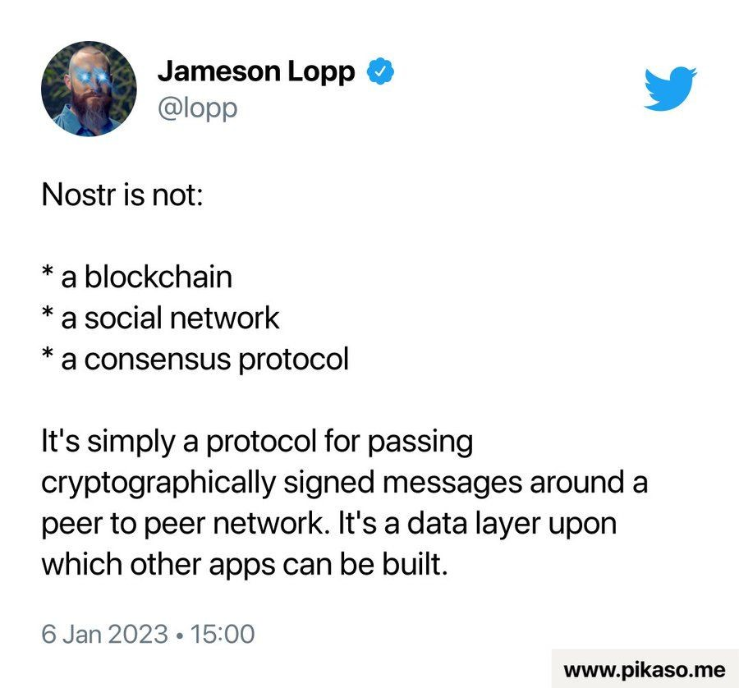
WHAT NOSTR ISN’T

Slide 3
WHAT NOSTR
an
open protocol for censorship-resistant
communication networks created by @fiatjaf
Users
Events
IS
Relays
Clients

Slide 4


USERS
Like the bitcoin protocol, nostr is permissionless.
To use the protocol a user generates a key pair: a public key and a private key
Public Key Like a username, it’s how others can find you.
Private Key For signing messages to prove authenticity.
*DO NOT SHARE

Slide 5
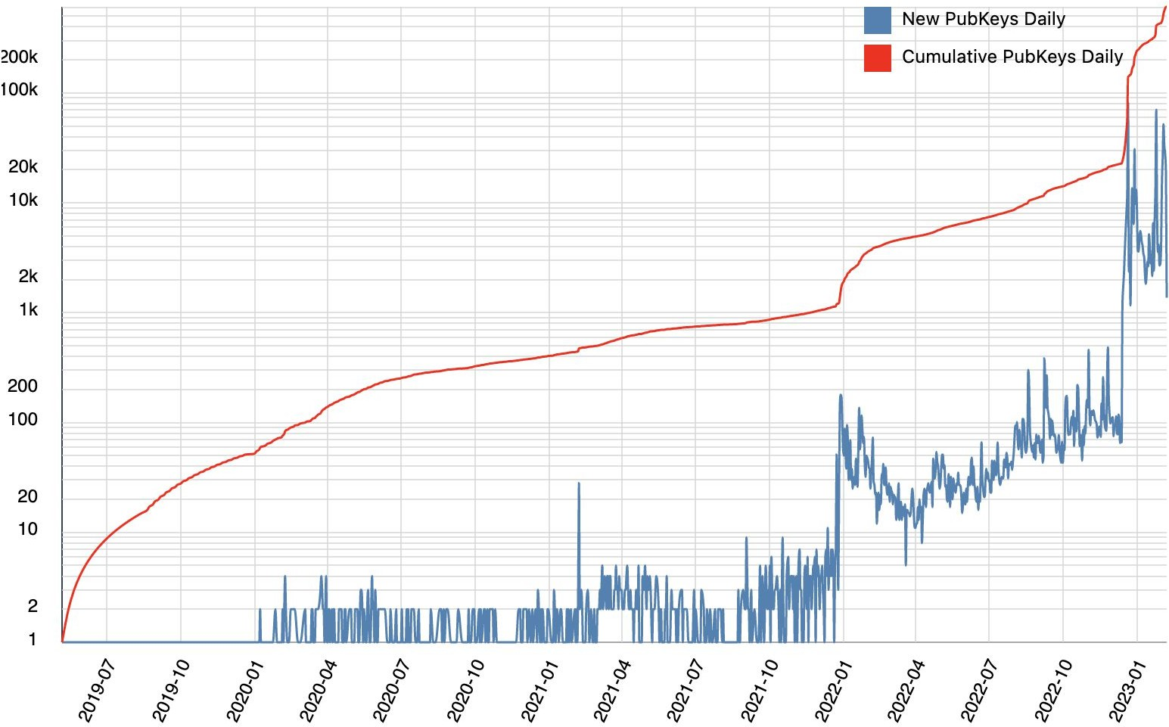
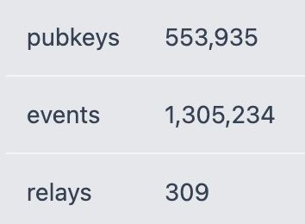
nostr.io (snapshot: 7 Feb 2023)

Slide 6

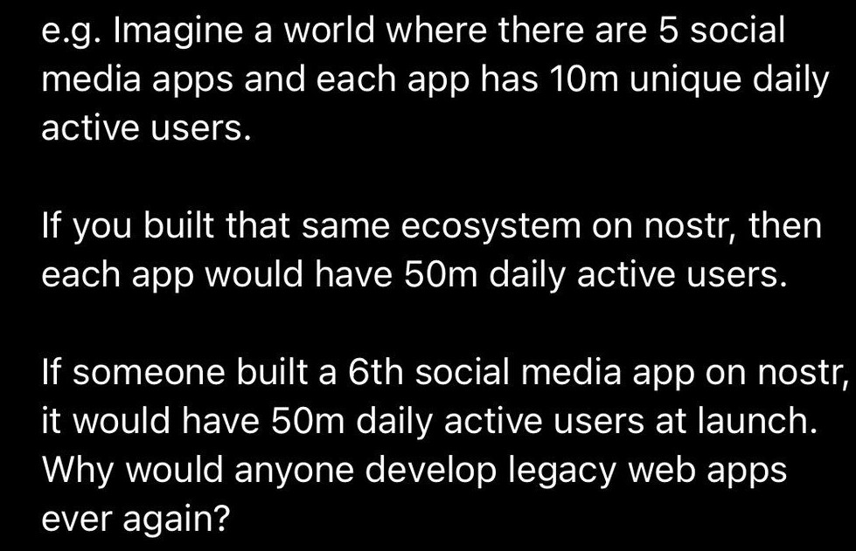
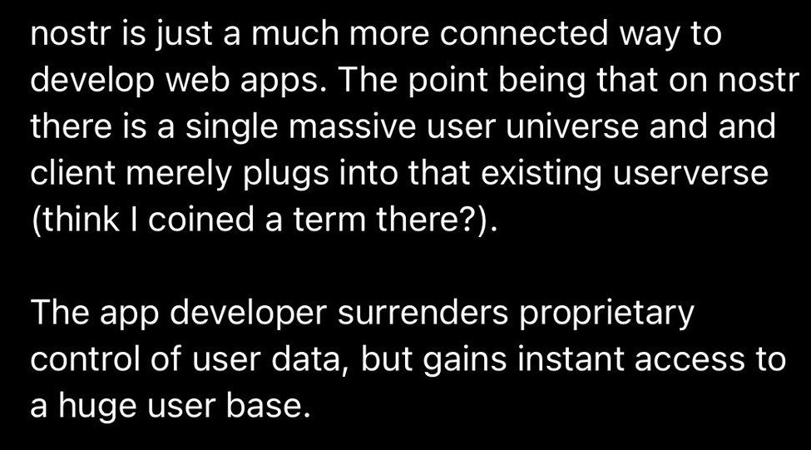
NOSTR PERMANENTLY ALTERS INCENTIVES

Slide 7
EVENTS
(simple text-based objects).
Nostr is a protocol for packaging ‘events’
When you post content, it’s not broadcast to all users nor sent directly to a particular recipient (P2P).
Instead, it is sent to a relay/s,
readable by users also connected to that common relay.

Slide 8
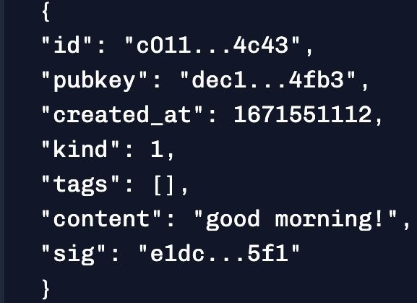
ANATOMY OF AN EVENT
Event’s unique identifier
User Timestamp
Type of event (e.g. plain
text note, E2E msg, etc.)
Tags (e.g. specify a post
as a reply to event x)
Message
Proof that this came from the user (signed with the user’s private key)

Slide 9
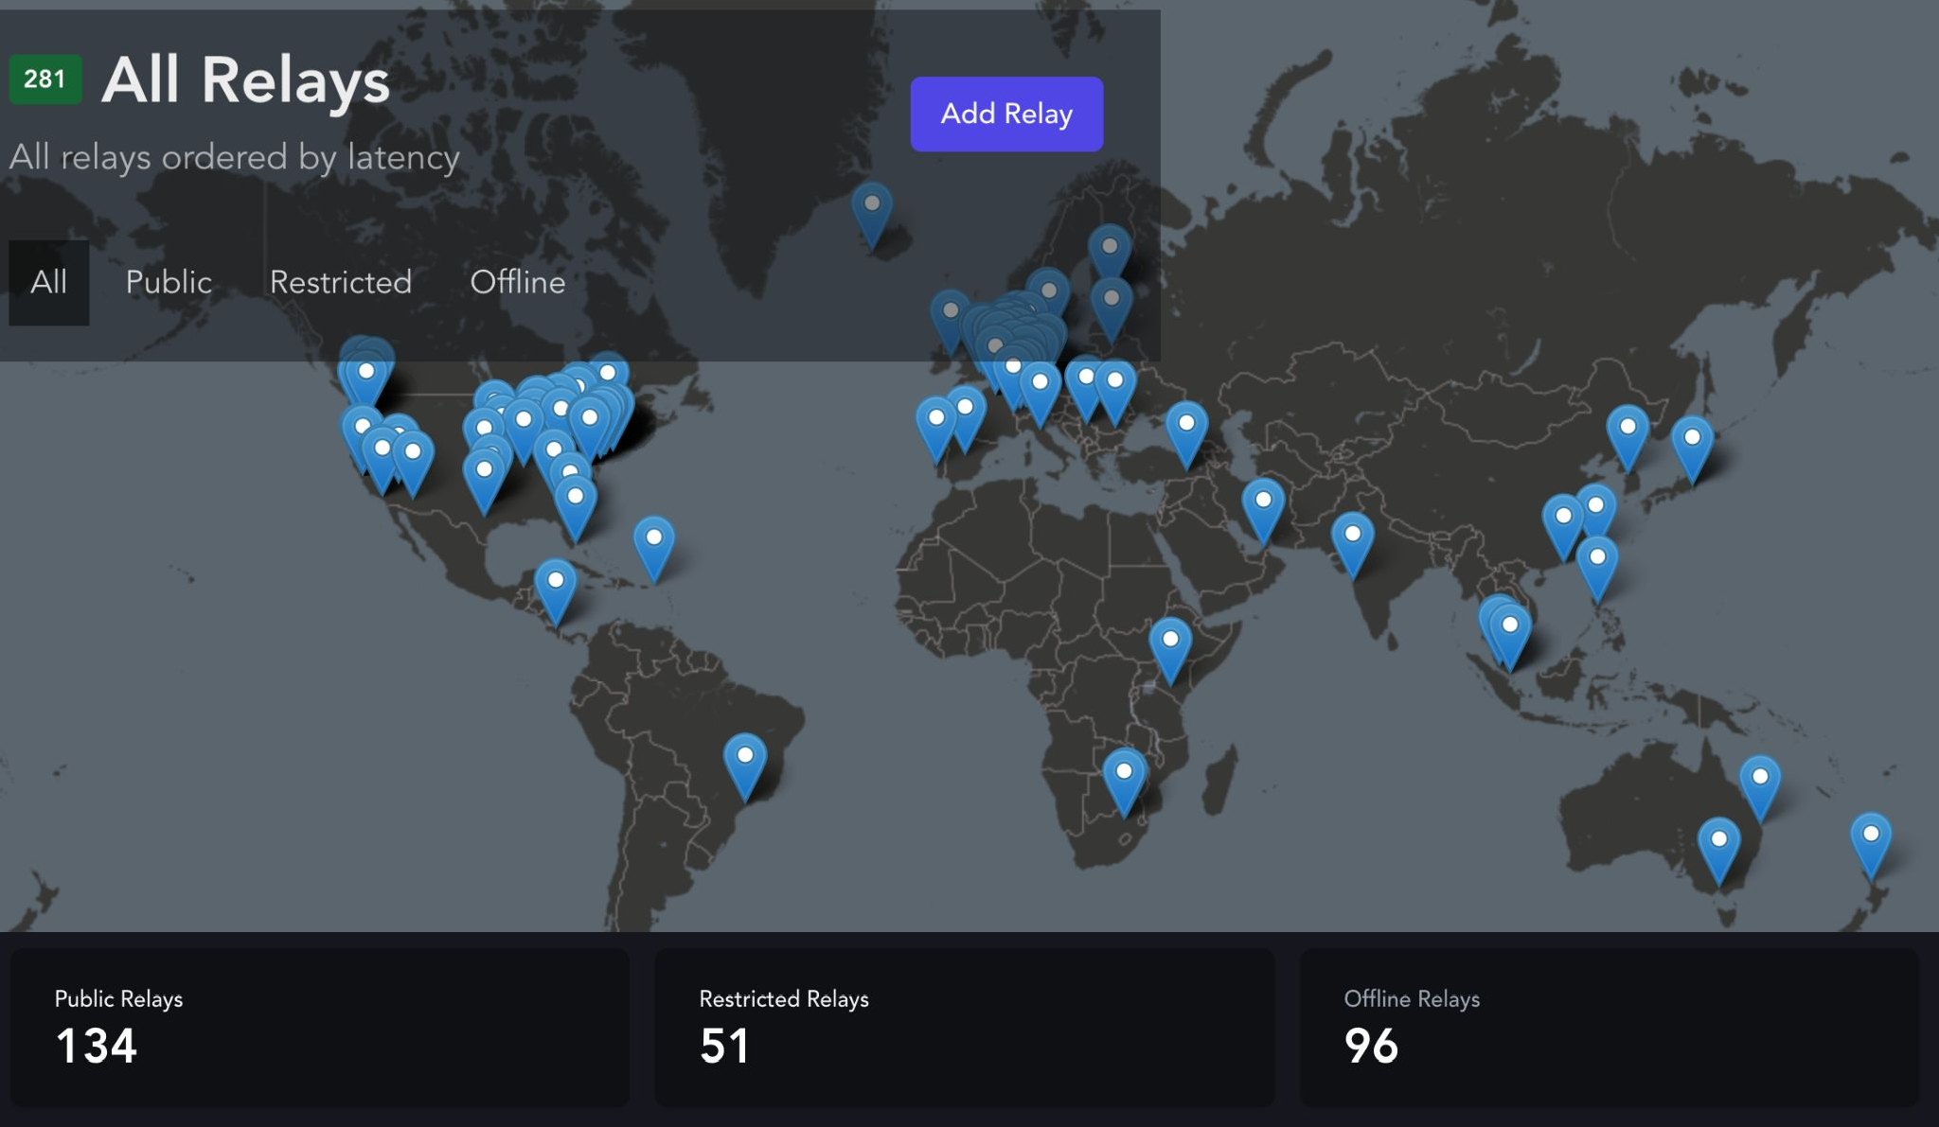
nostr.watch (snapshot: 7 Feb 2023)

Slide 10

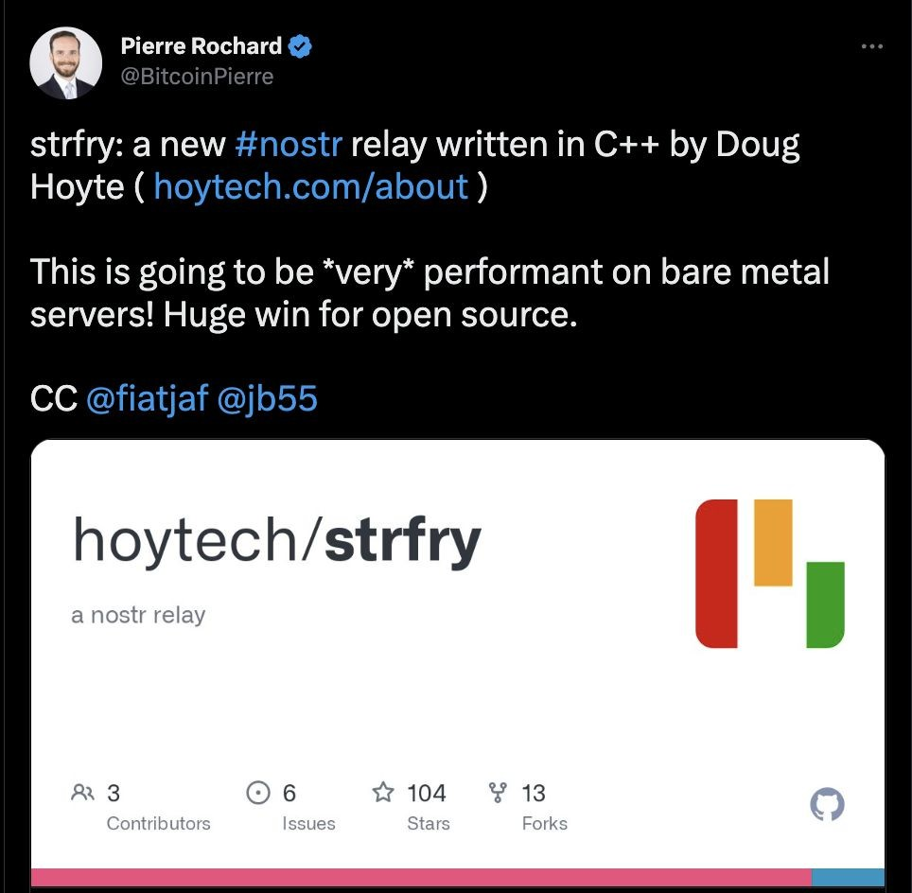
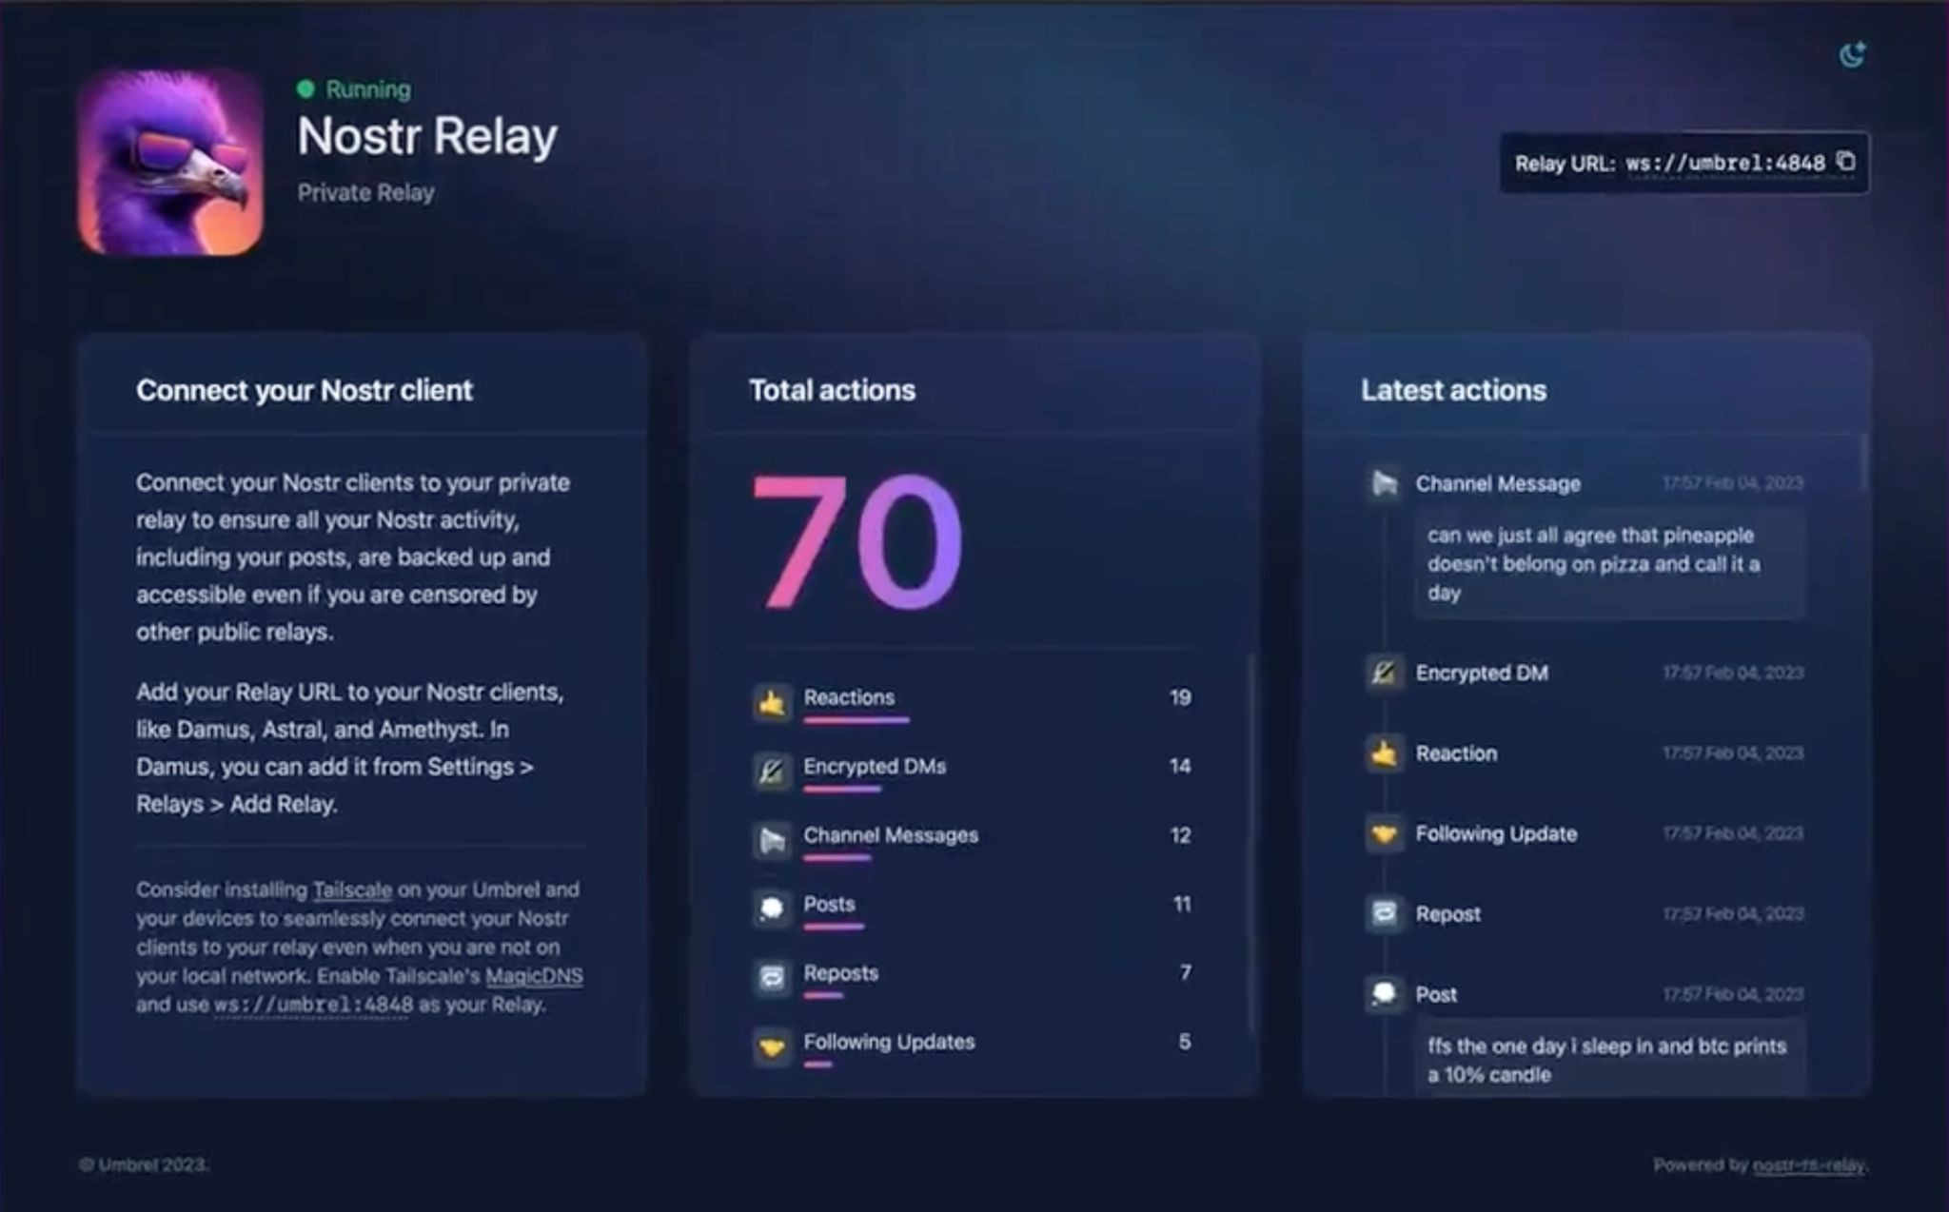
RUNNING A RELAY
Implementations
Plug & Play Services

Slide 11
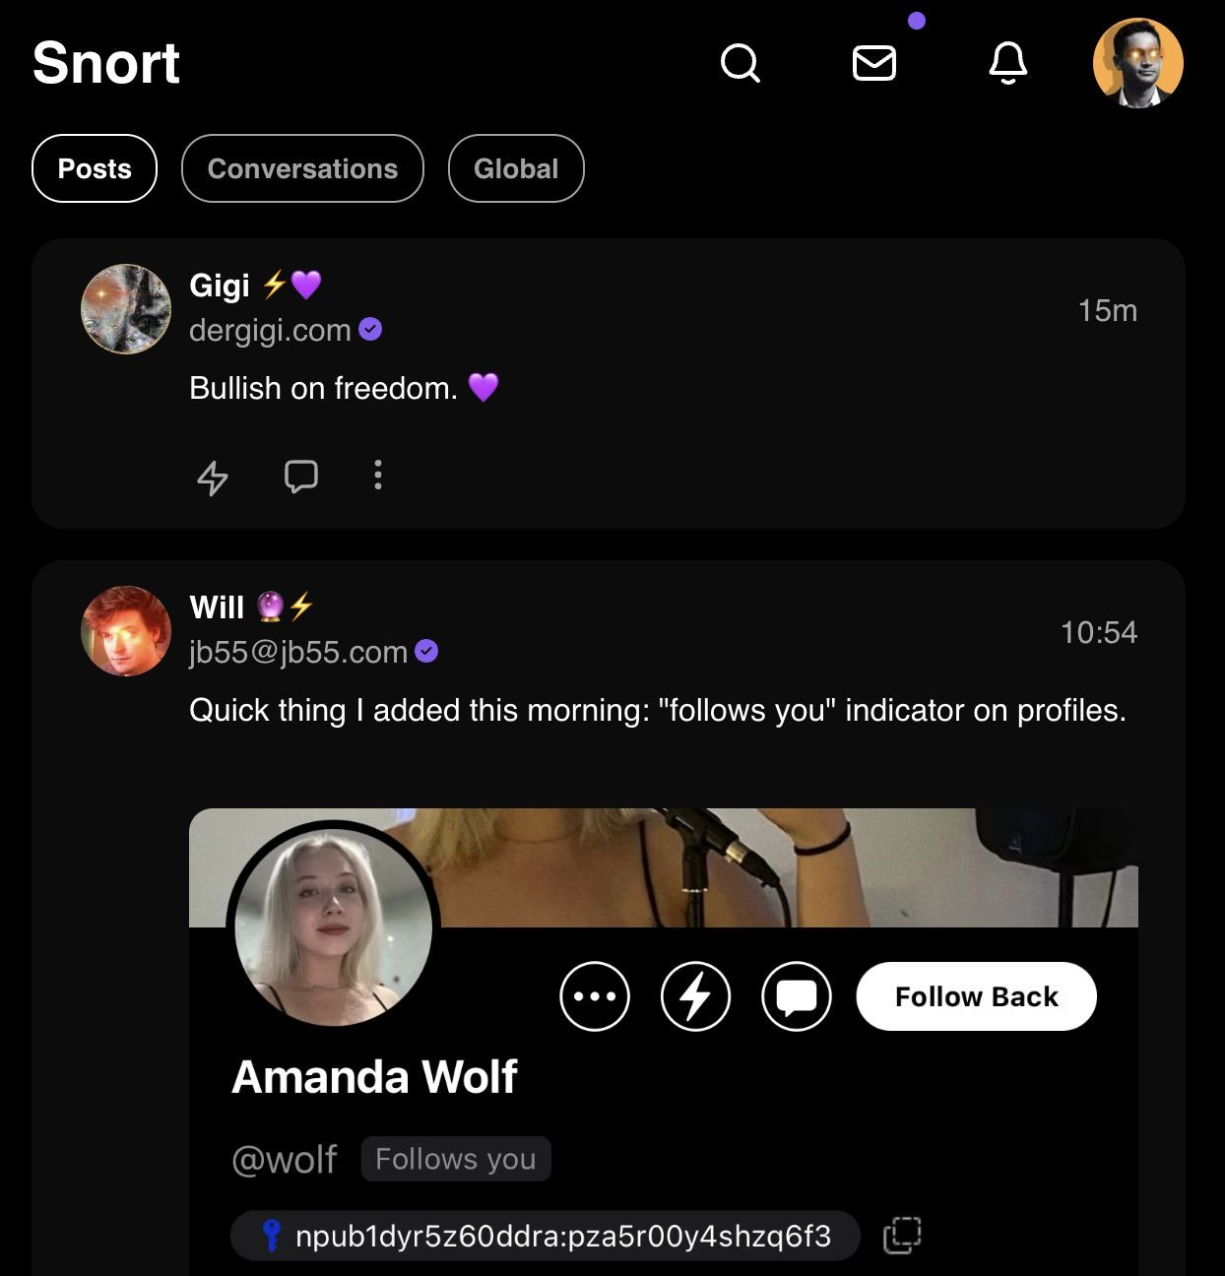

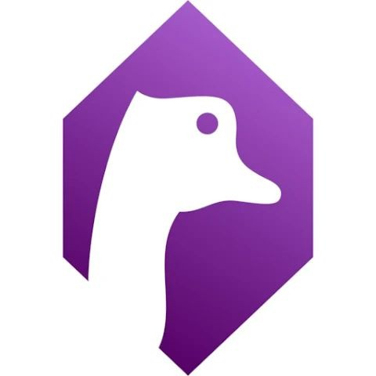

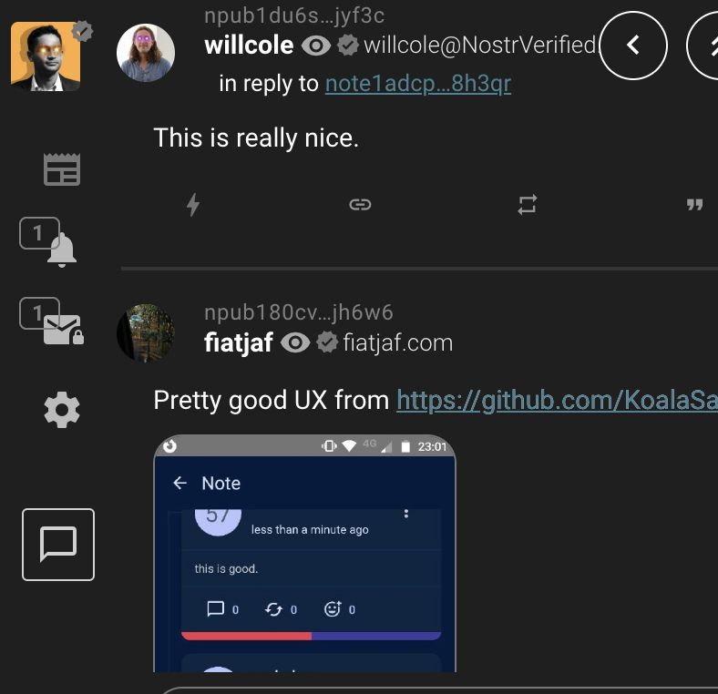
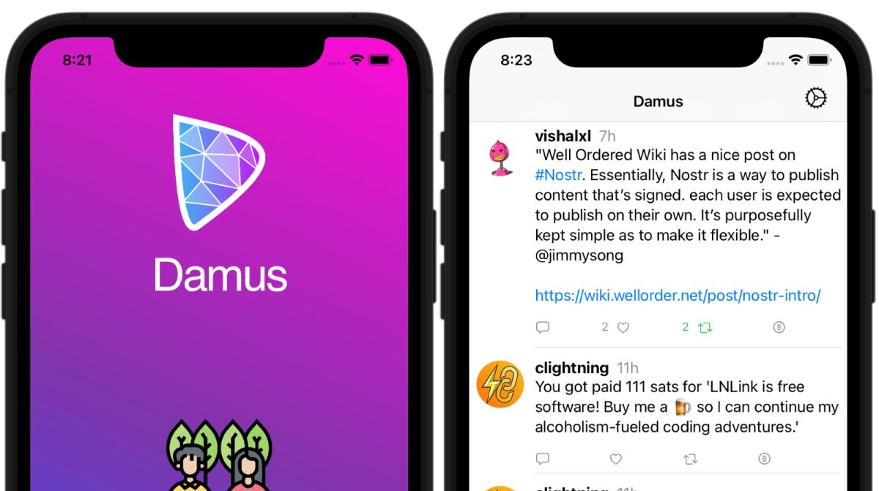
Web (browser)
CLIENTS
Mobile (iOS, Android)
Users interact with the nostr protocol through a ‘client’.

Slide 12
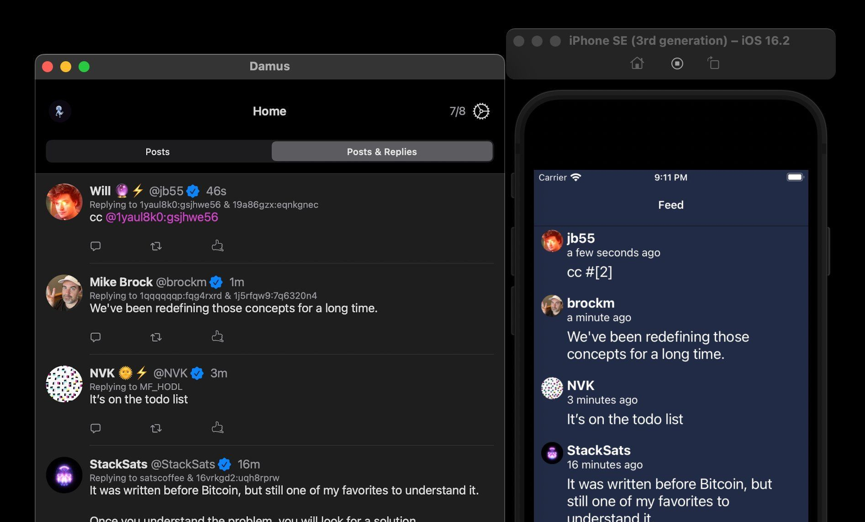
Client A
You can use any client you wish or even build your own.
Client B

Slide 13
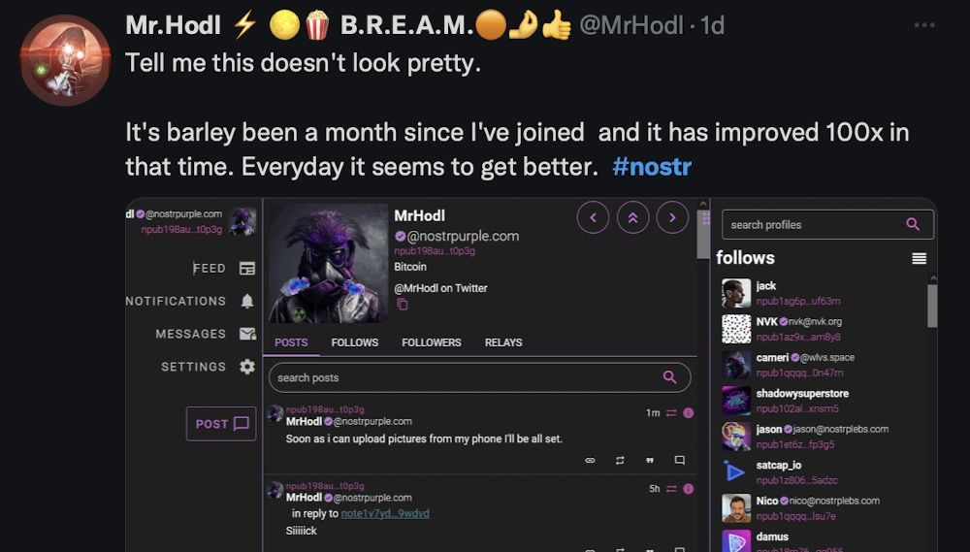
Permissionless innovation benefits from the collective contributions of many (hive mind), far exceeding what a single company could achieve.
SPEED OF INNOVATION

Slide 14

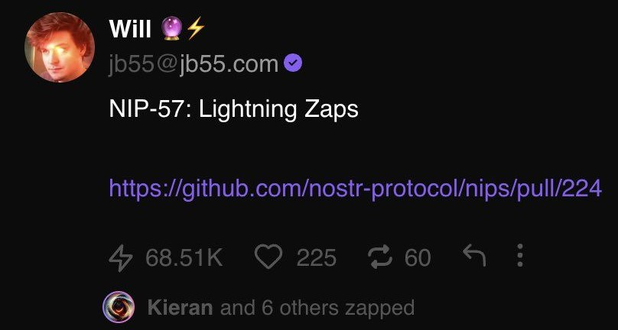
Nostr is an open protocol and interoperable with other open protocols.
Nostr Lightning Network
INTEROPERABILITY

Slide 15

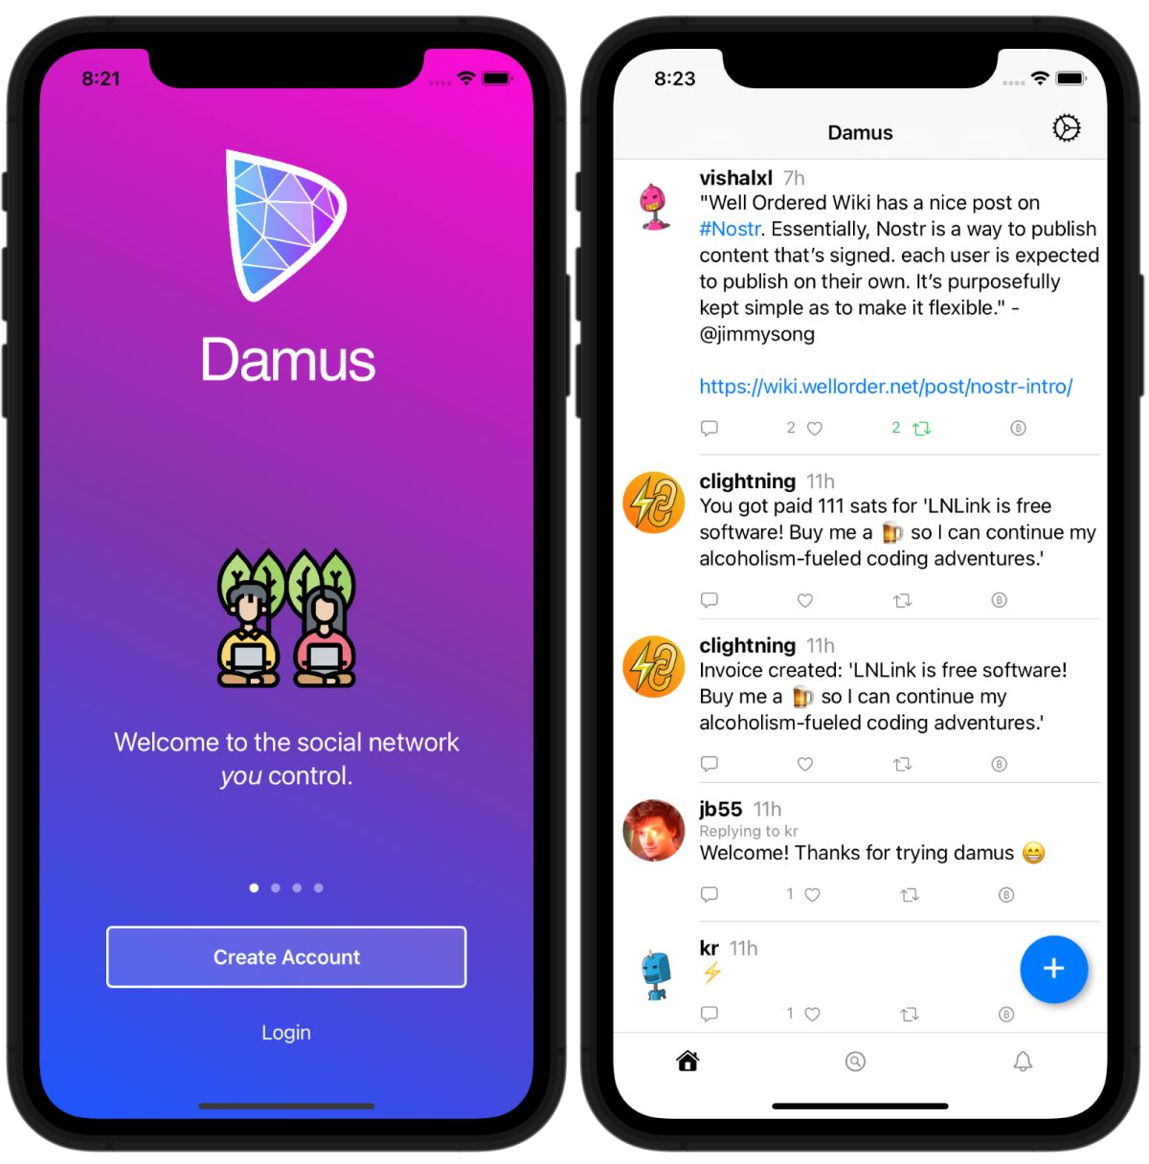
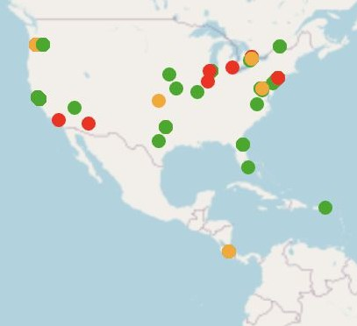
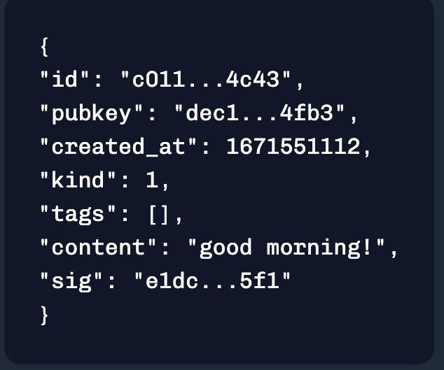
generate key pair
USER
create content & sign w/ priv key
pick a client
connect to relays
CLIENT
RELAYS
EVENT

Slide 16
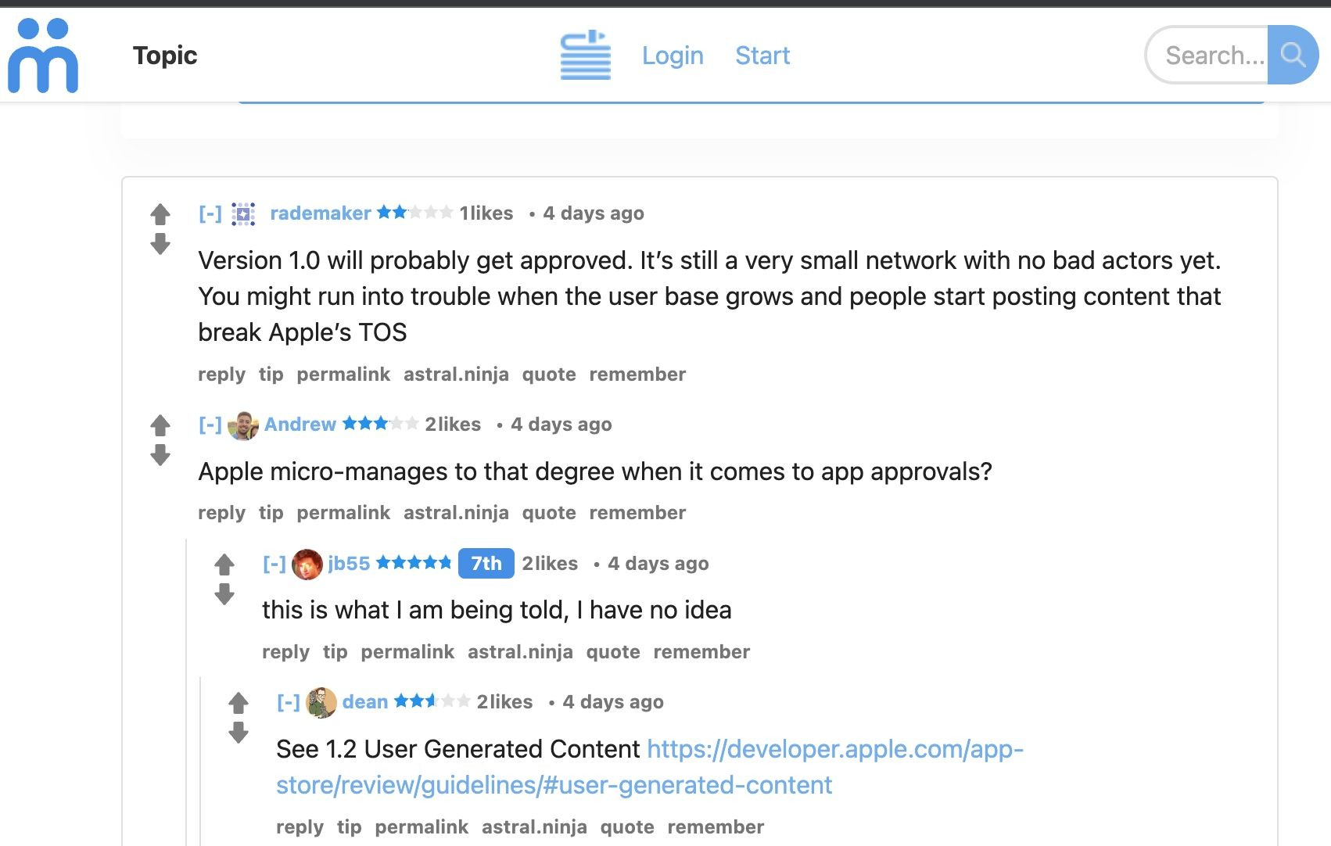
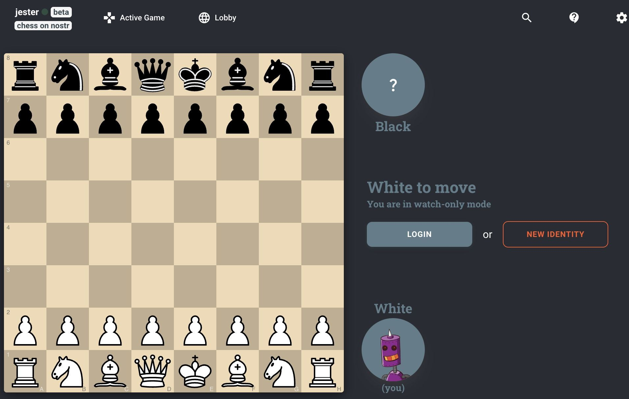
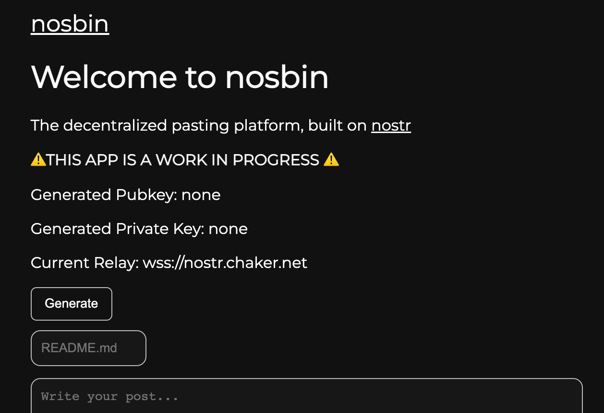
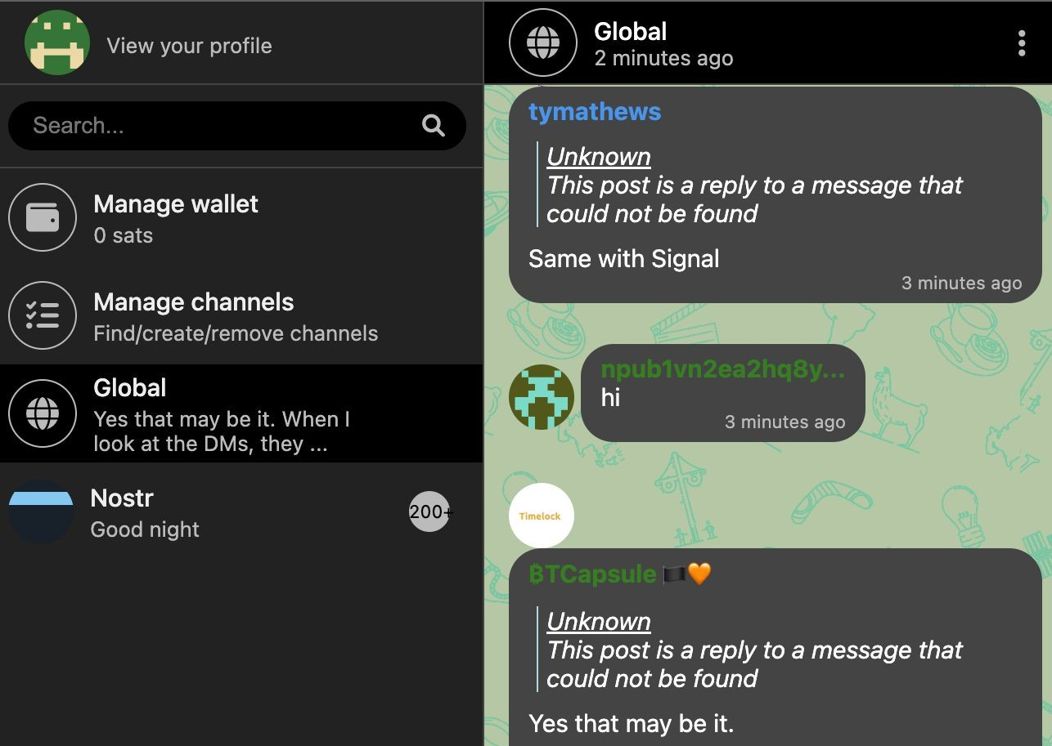
Games
Forum
OTHER EXAMPLE USE CASES
Pastebin
Chat

Slide 17



ANIL
@anilsaidso
npub14hn6p34vegy4ckeklz8jq93mendym9asw8z2ej87x2wuwf8werasc6a32x

